Slide 1

Insurance Analytics (P696)
Project Mentor
Mr. Arun Math
Mr. Anand

Slide 2

Meet Our Team Sreeja Lella Yash Sakure Ajay Shreshta Niranjan Kumar Lakshmikanth Reddy Minal Sandeep karade

Slide 3
Agenda
Project Goal & Insurance Analytics
Dataset Description
KPI Analysis
Dashboard Design
Recommendation
Conclusion
Closure

Slide 4

Project Goal
Branch dashboard to discuss New and Renewal business number with each branch. This dashboard will be discussed between Corporate team and Individual branch heads.
Discuss performance metrics in the branch.
Overall performance summary
Detailed branch performance
Key insights and action items
Summary of new, cross sell and renewal business numbers for the branch

Slide 5
Introduction
Insurance analytics is a project aimed at analyzing the performance of various branches and account executives of an insurance company. The goal of the project is to identify areas of improvement and help the company make data-driven decisions to increase revenue and customer satisfaction.
The problem statement for this project is to identify which branches and account executives are performing well and which ones need improvement. By analyzing various kpi’s such as number of invoices, yearly meeting count, and stage funnel by revenue, we can provide valuable insights to the company.

Slide 6

Dataset Description
Brokerage -> Contain information about clients' policies, including policy details, income, and renewal status.
Fees -> Contains data on client-related income transactions, including revenue details and transaction types.
Budget -> Details the budget allocations for branches and employees, including new roles, cross-sell initiatives, and renewals.
Invoice -> Holds information about invoices generated, including transaction details and associated clients.
Meeting -> Tracks meetings managed by account executives, including branch associations and attendee details.
Opportunity -> Documents details of opportunities managed by account executives, including revenue, stages, and risk information.

Slide 7
KPI Analysis
No of invoice by Account Executive
Yearly Meeting Count
Target, New, Achieve
Cross sell, New, Renewal
Stage Funnel by Revenue
No of meeting by Account Executive
Top open opportunity

Slide 8
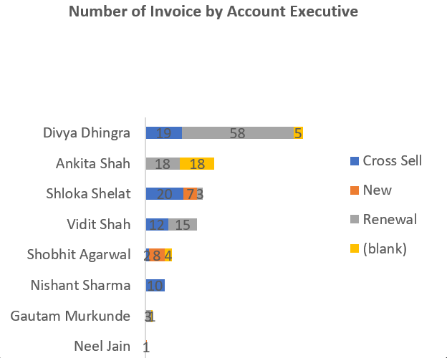
KPI 1. No. of invoice by Account Executive
Measure the volume of invoices generated by each account executive within a specified time period.
Analyze trends and patterns in invoice generation to identify top-performing account executives.
Assess the impact of account executive performance on overall revenue and profitability
Use data visualization techniques to present findings in an easily understandable format.
Identify outliers or discrepancies in invoice counts to ensure accuracy in reporting.

Slide 9
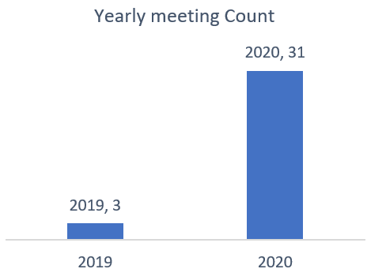
KPI 2 Yearly Count Meeting
Measure the total number of meetings held within the project team over the course of a year.
Analyze trends in meeting frequency to assess project progress and team engagement.
Include both scheduled and ad-hoc meetings to capture the full extent of collaboration.
Set benchmarks for meeting frequency based on project milestones and deliverables.
Evaluate the effectiveness of meetings in achieving project objectives and resolving issues.

Slide 10
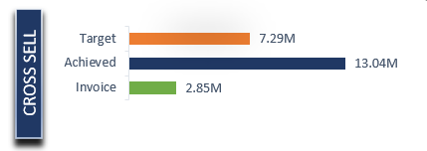
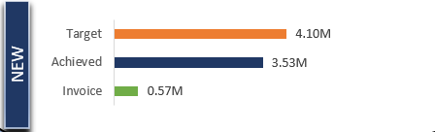
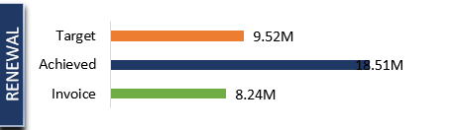
KPI 3 Cross Sell, New & Renewal

Slide 11
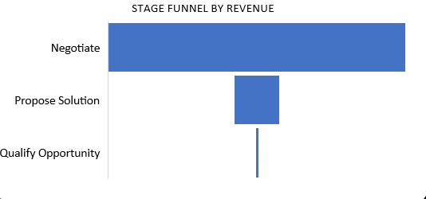
KPI 4 Stage Funnel by Revenue
In the context of a Stage Funnel by Revenue for an insurance analytics project, KPIs are metrics used to measure the performance and effectiveness of the various stages in the sales or customer acquisition process, specifically focusing on revenue generation.

Slide 12
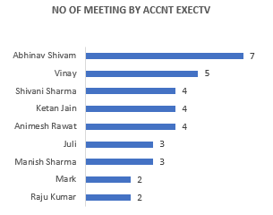
KPI 5 No of meeting by Account Executive
The Number of meetings generated by Account Executive for refers to the total count of meetings scheduled or initiated by the Account Executive with potential clients, stakeholders, or decision-makers specifically related to the insurance analytics project within a defined period.

Slide 13
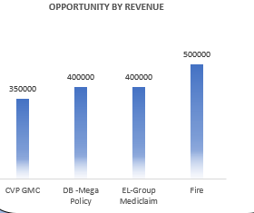
KPI 6 Top Open Opportunity
Opportunity Prioritization: This chart can guide sales teams in prioritizing their efforts and allocating resources to focus on opportunities with the highest revenue potential (like Fire).
Sales Strategy: The information can inform the development of tailored sales strategies for each opportunity type, considering factors like pricing, negotiation tactics, and value proposition.
Resource Allocation: This visualization can help determine the optimal allocation of sales resources based on the revenue potential of different opportunity types.

Slide 14
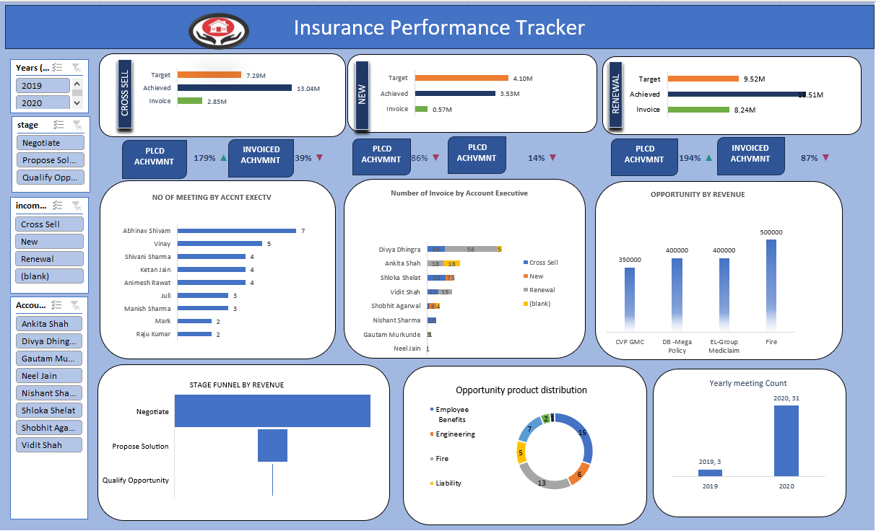
Excel Dashboard

Slide 15
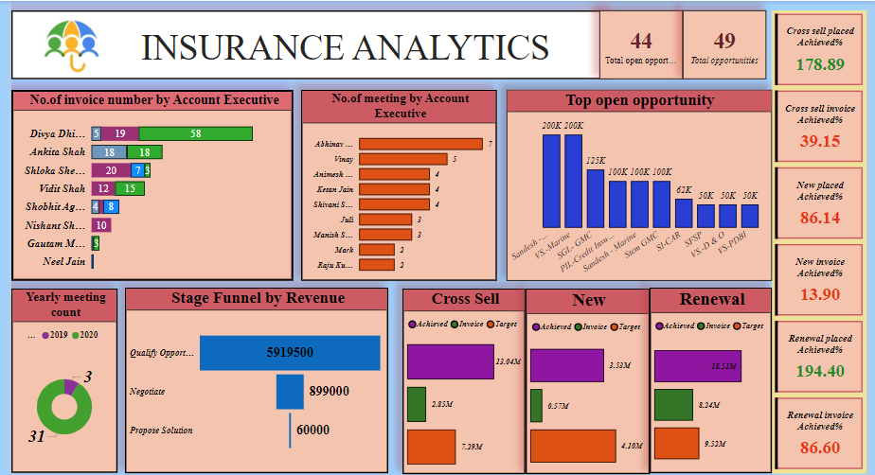
Powerbi Dashboard

Slide 16
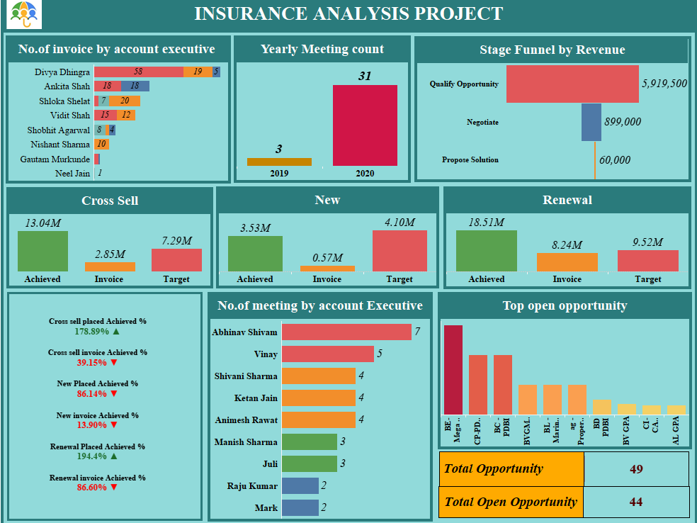
Tableau Dashboard

Slide 17
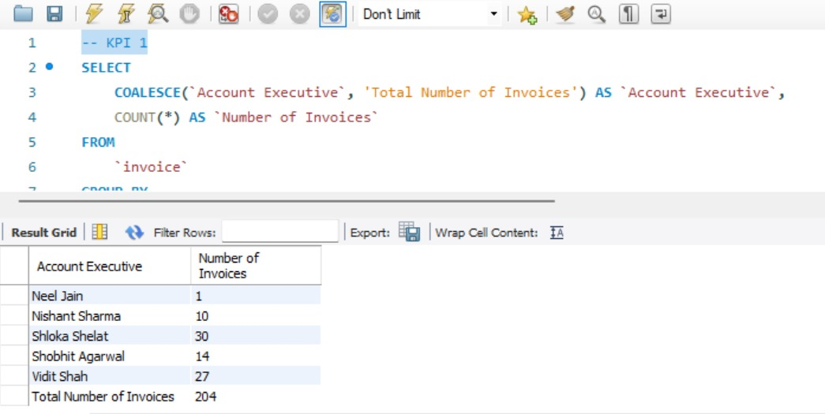
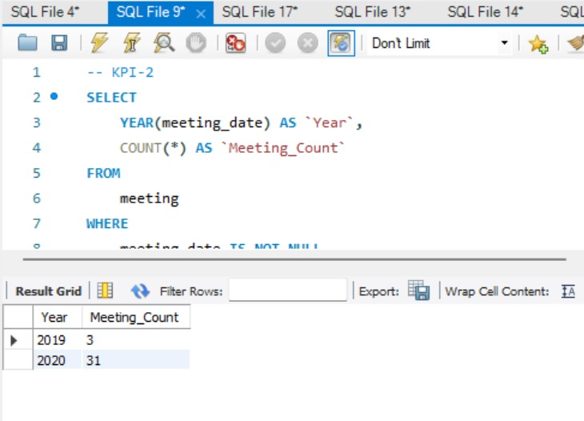
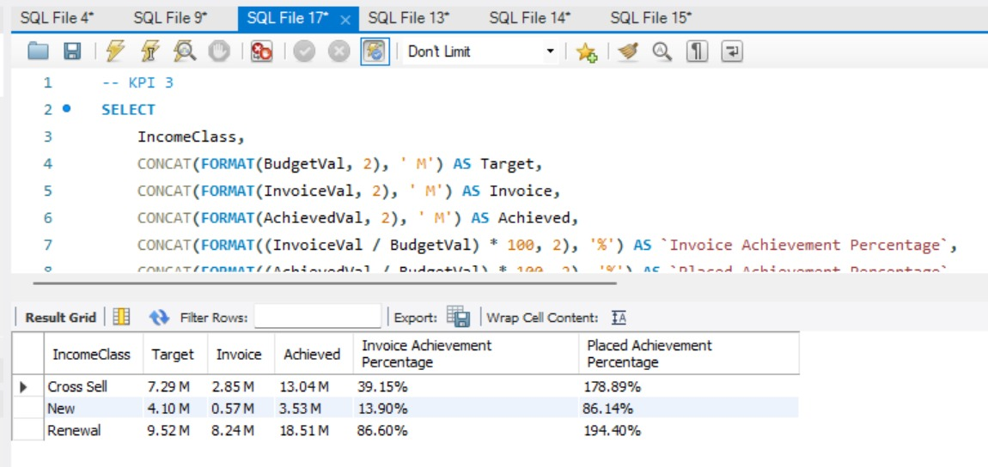
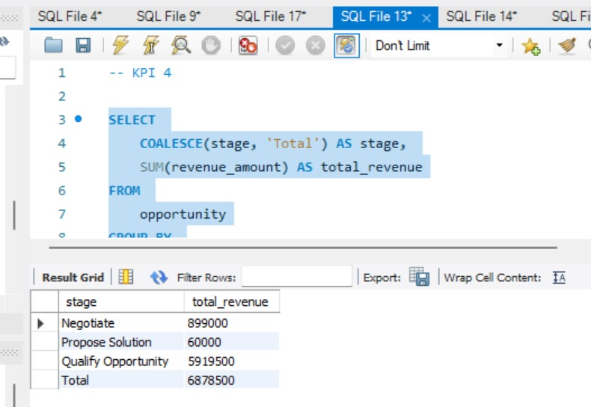
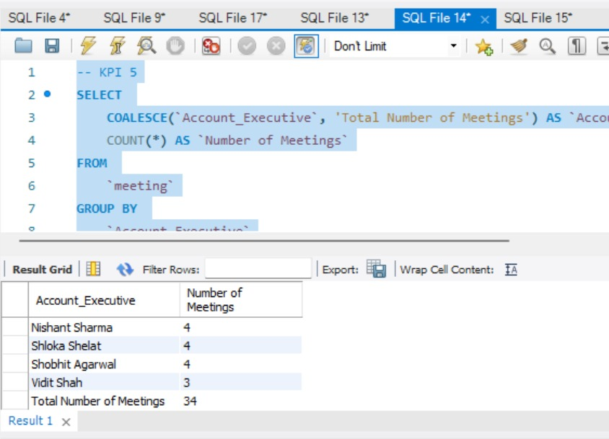
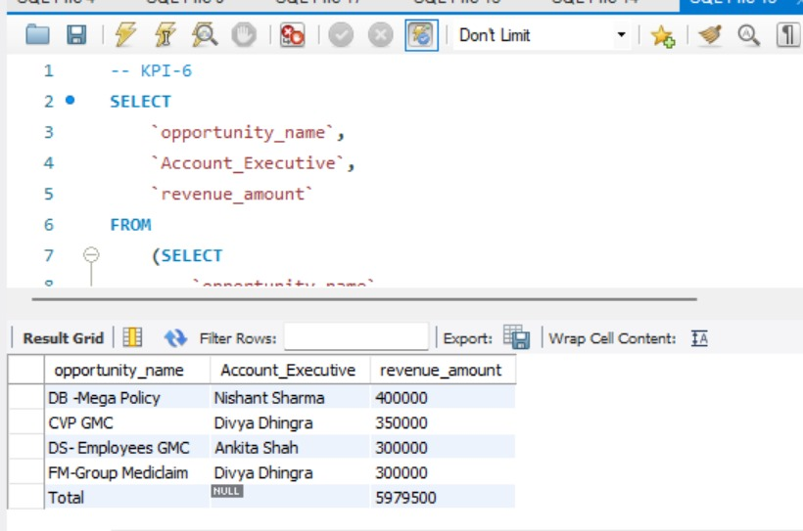
SQL Queries

Slide 18

Conclusion
The project demonstrated the value of data and dashboards in decision making and business insights.
Tools like Excel, SQL, Power BI, and Tableau were used for analysis and visualization.
Accurate data and meaningful dashboards support process optimization and risk reduction.
By leveraging advanced analytics, this project aims to empower insurance companies to make data-driven decisions, mitigate risk effectively, and ultimately enhance their competitive advantage in the market.

Slide 19
Suggestions
Enhance Customer Service.
Implement AI-driven chatbots for 24/7 customer support. Train staff on customer engagement and conflict resolution.
Expand Product Offerings
Introduce new insurance products tailored to emerging markets. Bundle products for better value to customers.
Increase Sales and Retention
Launch personalized marketing campaigns based on customer data. Introduce loyalty programs to reward long-term customers.
Market Analysis and Adaptation
Conduct market research to identify customer needs and preferences. Adjust strategies based on competitive analysis and market trends.
Employee Engagement
Foster a positive work environment to boost employee morale. Introduce employee recognition programs to retain top talent.
Enhance Operational Efficiency
Conduct regular training sessions for employees on new technologies. Team collaboration activities

Slide 20

Thank you

